Slide 1
Libraries, copyright and the World Intellectual Property Organisation
IFLA, 1 November, 10h CEST, The Hague
Notes:
Welcome to this short IFLA webinar about our work on libraries and copyright at the World Intellectual Property Organisation. Thank you for being here, and I hope you’ll find this useful.
We’ll aim to keep this presentation relatively short, in order to allow time for questions at the end. Your microphones are muted and we’d be thankful if you could keep it this way.
The webinar will be recorded and made available afterwards on the IFLA website together with the power point presentation.

Slide 2
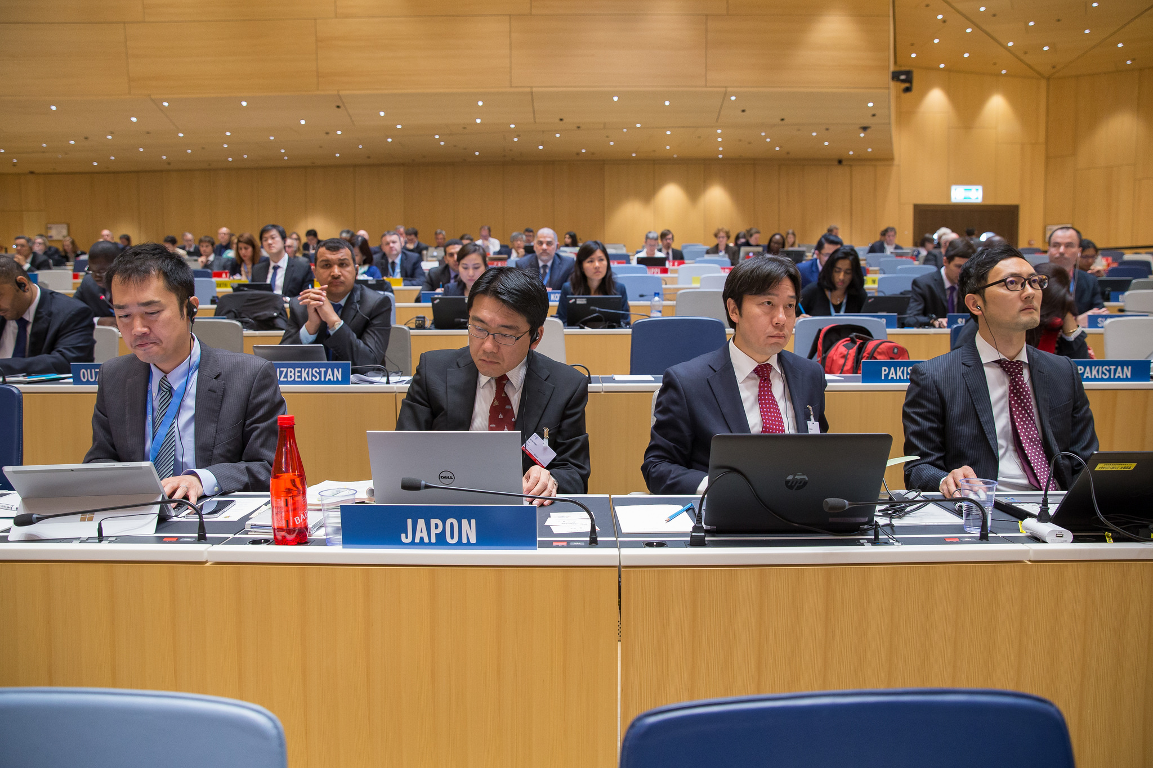
WHY do we engage?
WHAT are we doing?
HOW can you help?
Notes:
So the contents of this webinar can be summarised as the answers to three questions - why we engage at WIPO, what we are doing, and what you can do to help us. So note now – there may be some homework at the end of this.

Slide 3
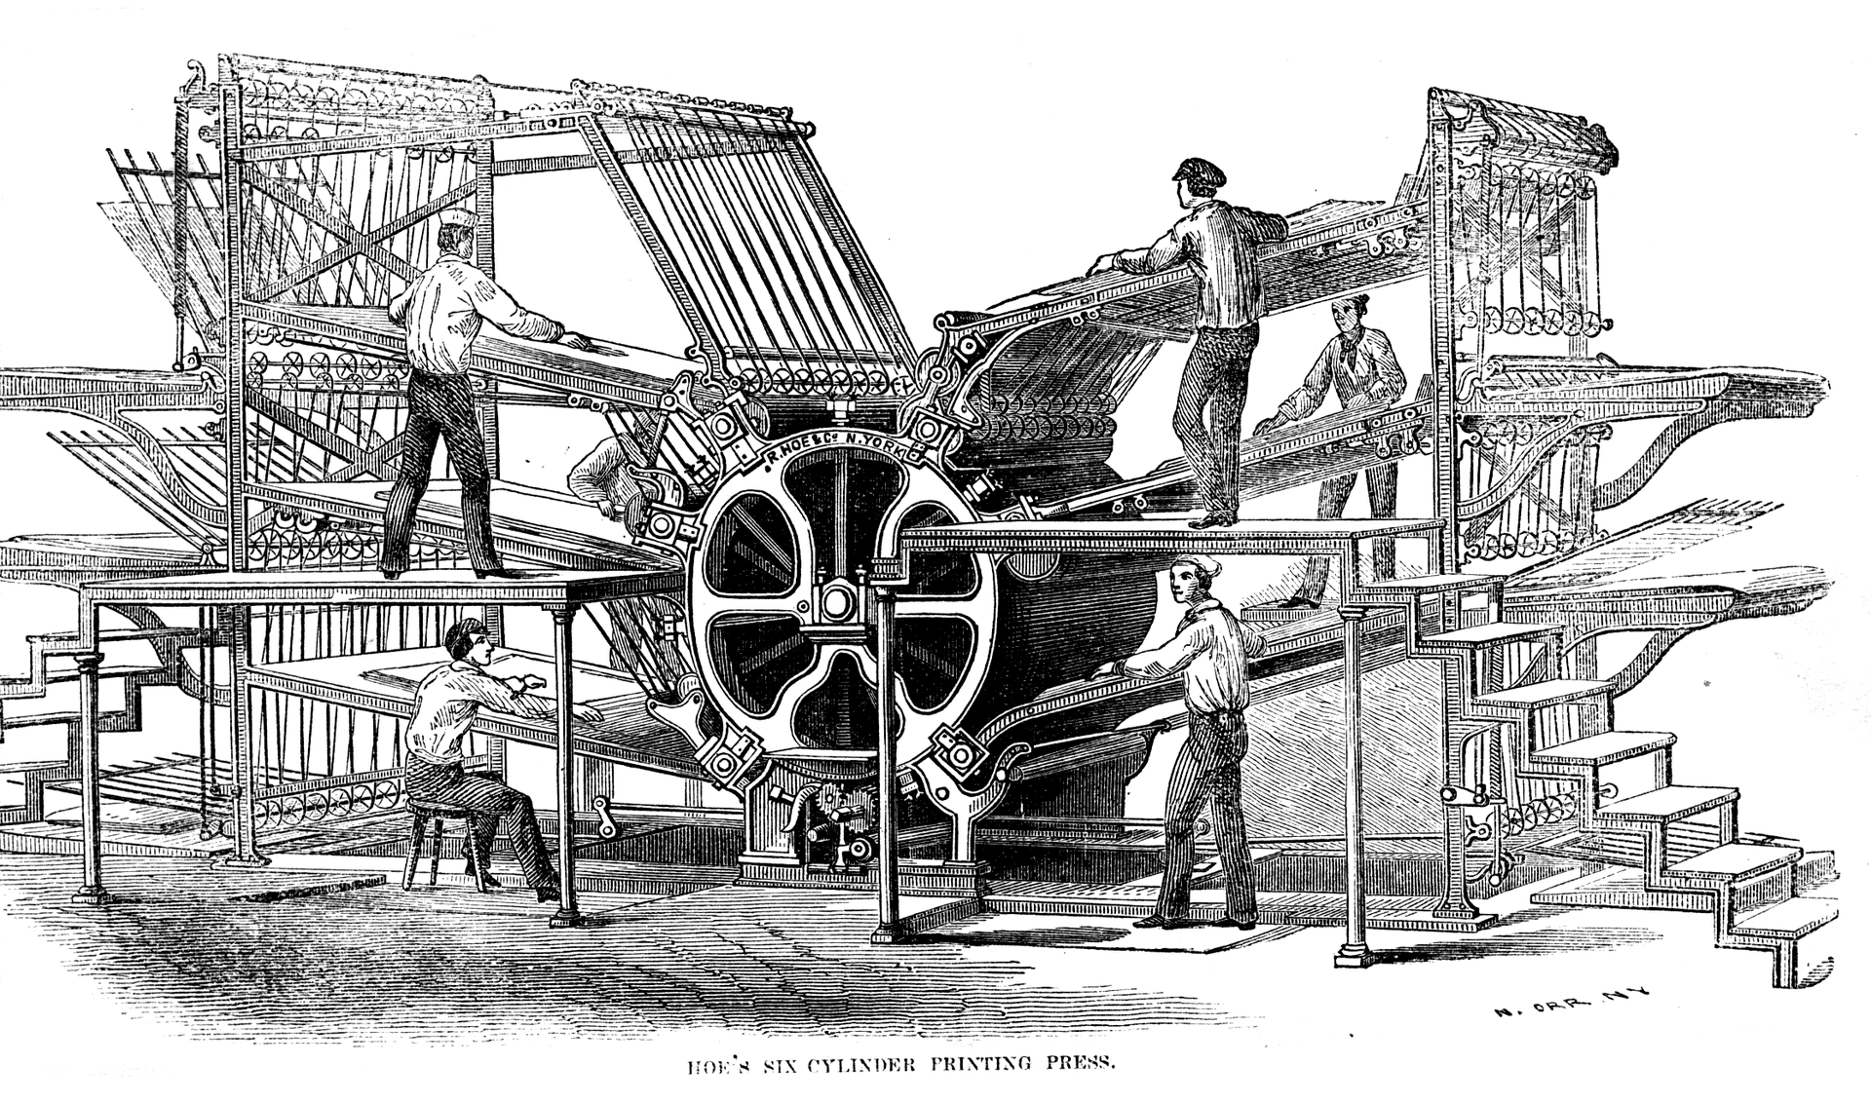
Berne Convention
Obligatory Protections,
Optional Exceptions
Notes:
Looking first at why we engage, it makes sense to go back to the Berne Convention, the original international copyright instrument. Signed in 1886, it has been updated from time to time, but builds on a core differentiation between rights – not only for authors, but for a number of others – which are obligatory for all, and exceptions and limitations – which are defined nationally for the most part.
Rights cover activities such as reproduction, distribution, translation, recitation, and communication to the public, for a minimum of life plus fifty years, at least for primary rightholders. In some cases, such as photographs, sound recordings, or anonymous works, terms may be shorter. Other related rights, are available for different players such as performers.
Exceptions and limitations are optional, except for quotations and news of the day, and even then must comply with ‘three step test’ – that they concern a ‘certain specific use’, that they do not conflict with the normal exploitation of a work, and that they do not unreasonably prejudice the interests of the rightholder.
Fortunately, many countries have moved to legislate for exceptions and limitations, although we are a long way from a complete set in countries.

Slide 4
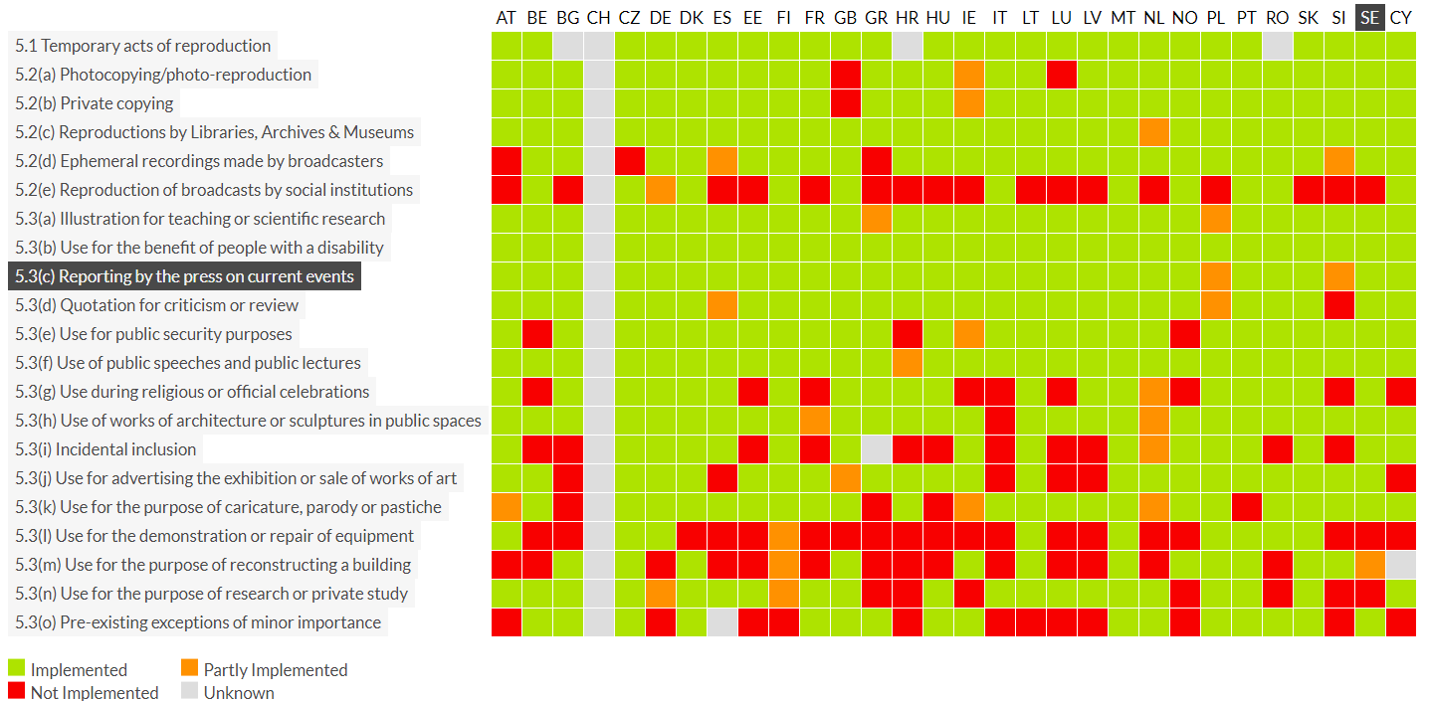
Notes:
The result is a strong unevenness. This image, taken from copyrightexceptions.eu, looks only at Europe, showing quite how patchy uptake of different copyright exceptions and limitations really is.
This is also only half of the picture, given that even when two countries have provisions in a particular area, for example for giving access to people with disabilities, they may be implemented or interpreted differently. And of course at the level of individual works, the contracts signed for access add a further level of complexity.
The first implication is that students, researchers, users and creators in one country may not enjoy the same possibilities as those in another. Contrary to the claim that more protection is linked to greater prosperity, the example of the US, as well as that produced by the Australian Productivity Commission recently, suggests that excessive protection is harmful, and that exceptions promote both economic and social welfare.
The second implication is that when libraries are looking to work across borders – for example to acquire works, to undertake preservation projects, or to supply documents, they could face a completely different copyright environment from one state to the next. That’s around 17000 potentially different combinations of copyright rules that librarians risk being forced to cope with in order to carry out public interest activities.
This is becoming more of a problem as, thanks to technological progress and the obvious benefits, libraries look to carry out more international activities. Too often, requests for materials through document supply fall down because of uncertainty or potential infringement, or preservation projects cannot go ahead.

Slide 5
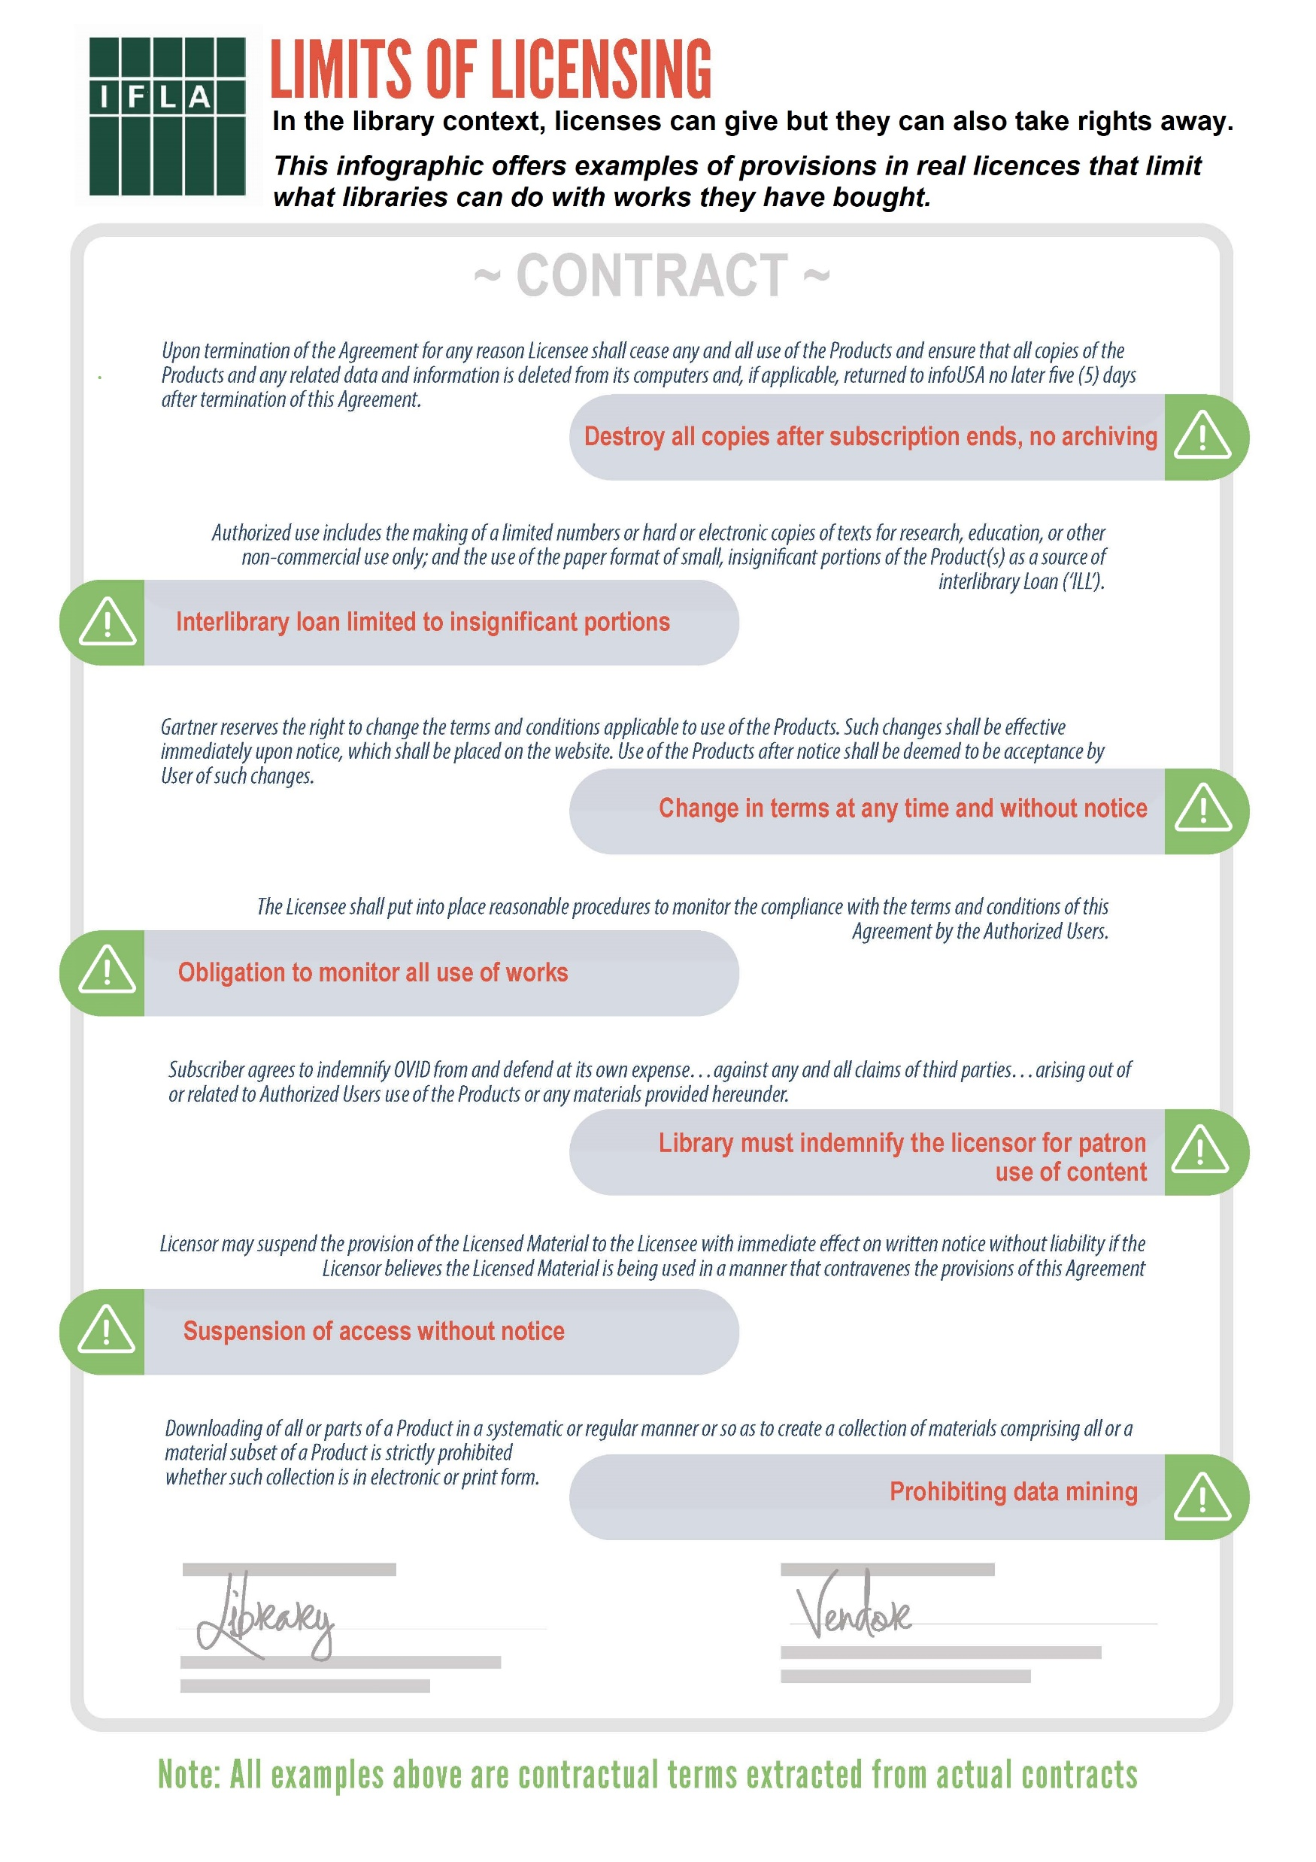
As research and preservation activities become international, the problem grows bigger…
… while new problems linked to digitisation emerge
Notes:
A second emerging challenge is around digital. The move from buying physical works to licensing access to digital ones effectively privatises much of the operation of copyright. Clearly the move to licensing is a fact of life, and libraries can and should do their best to use these effectively.
However licences are far from suitable in all cases, and, as can be seen in our infographic, licensing contracts can override the possibility to archive works, loan them to other libraries (even on a non-commercial basis for private study), or block data mining. Indeed, where there is no rule to say that such contract terms are non-enforceable, legislation itself risks becoming irrelevant.
As a result, an already imperfect copyright system risks becoming ever more out-of-date faced with trends towards internationalisation and digitisation.

Slide 6
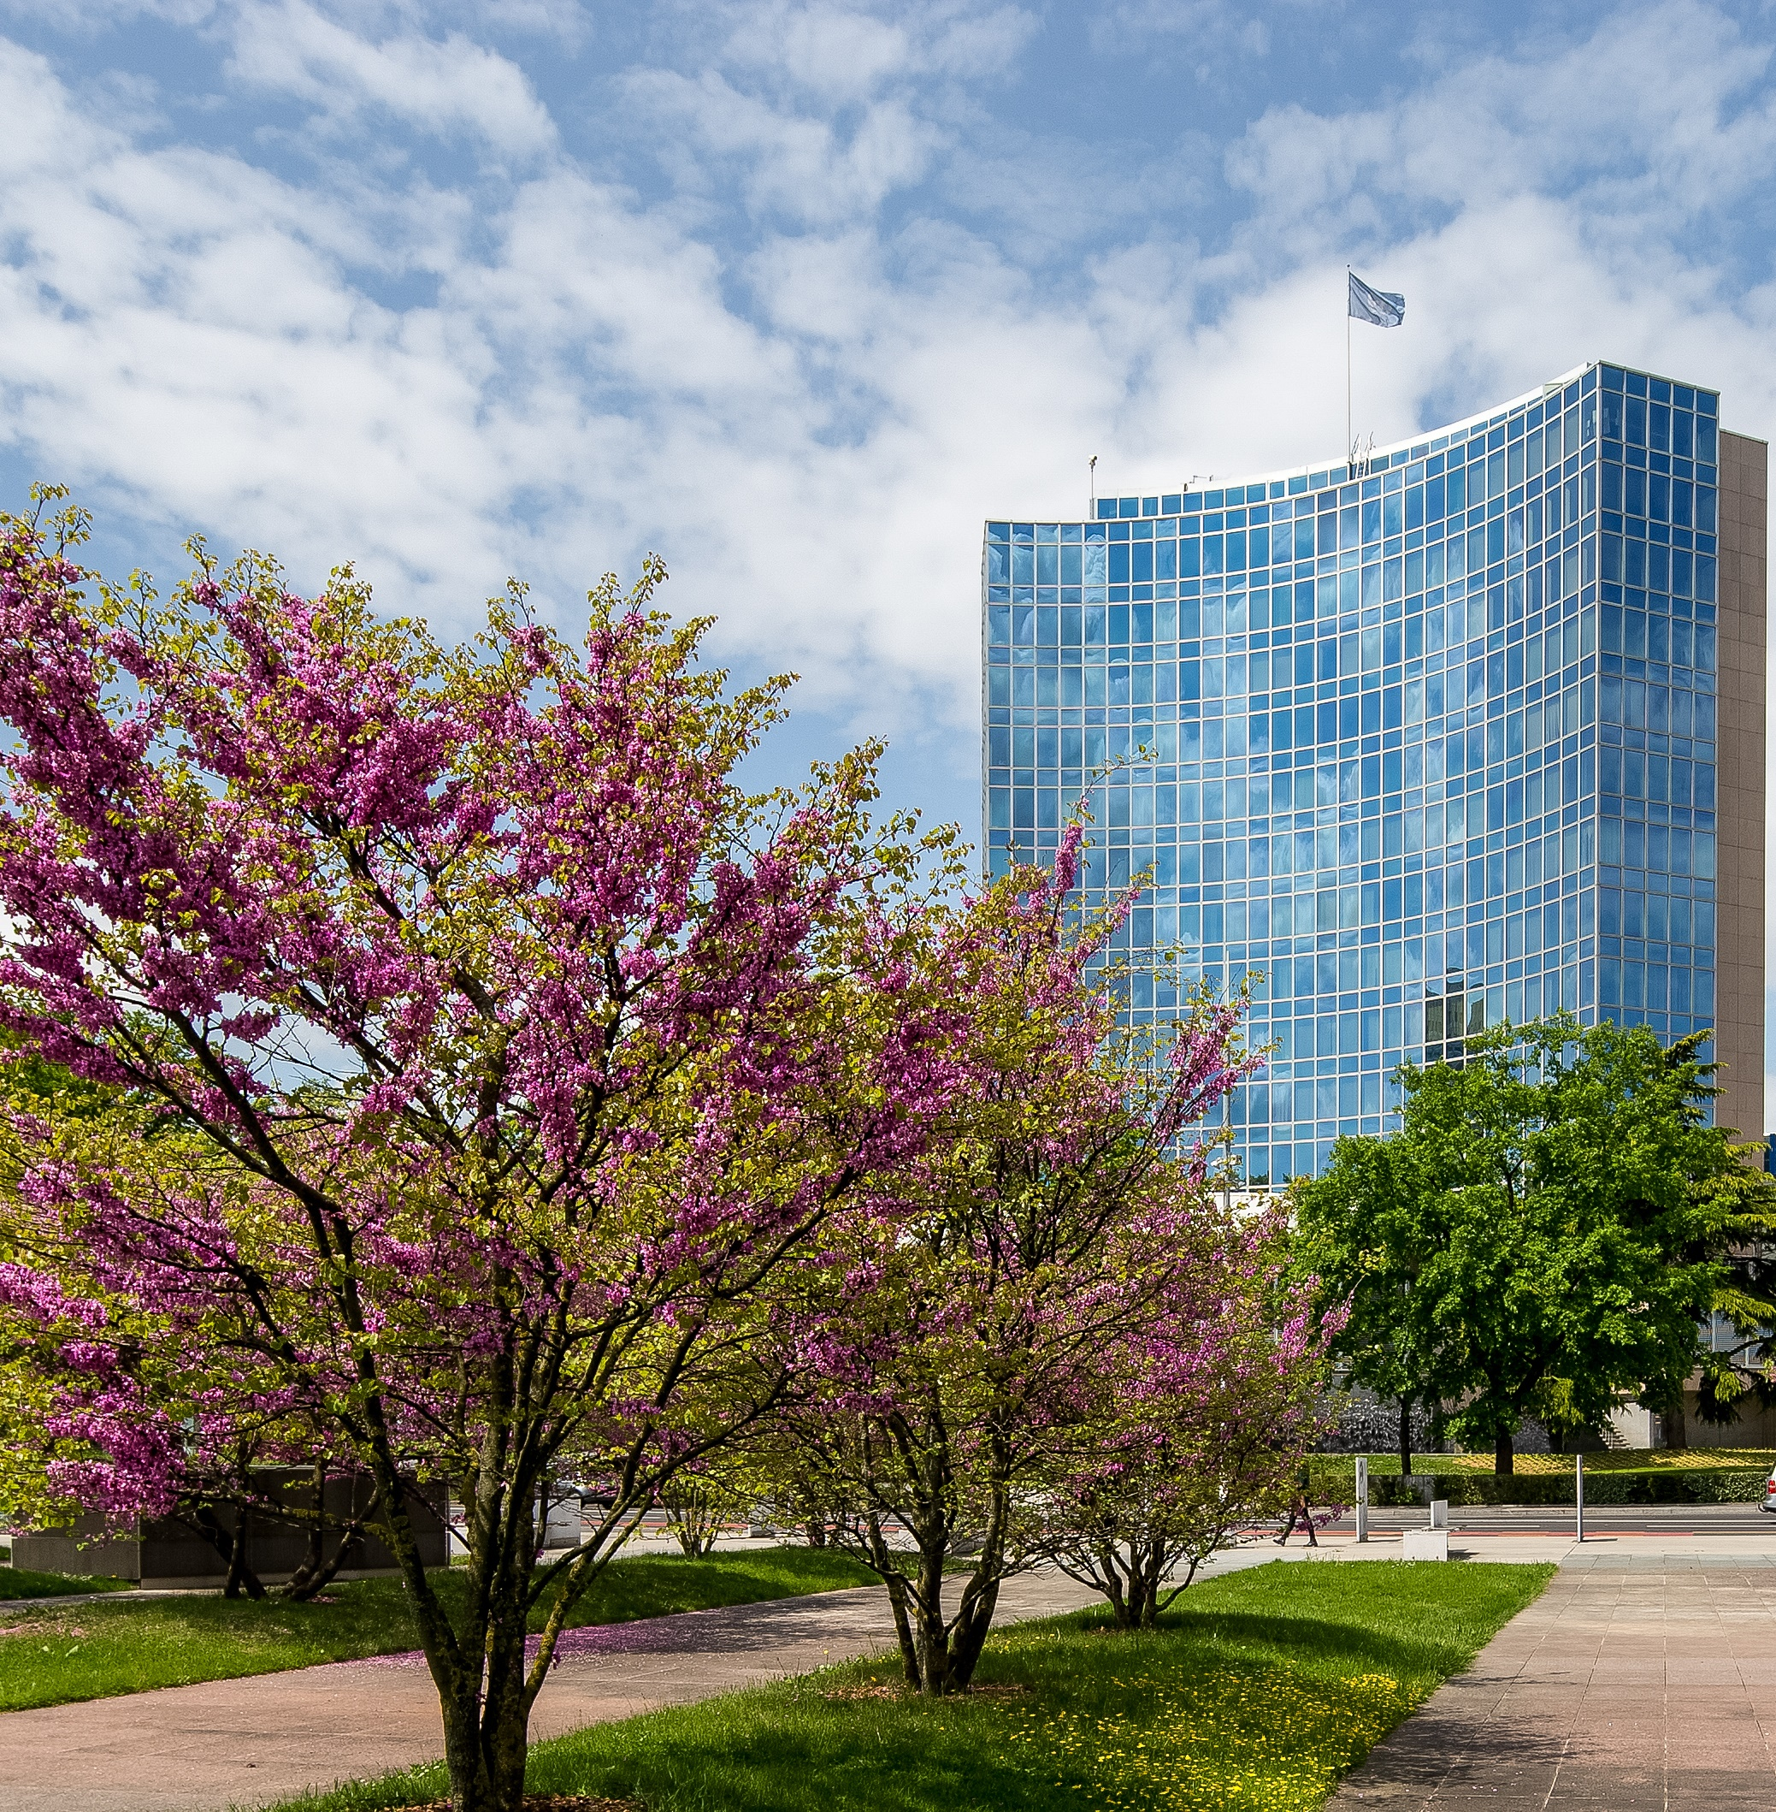
WIPO
191 Members, UN Body
Focus on copyright, patents, trademarks, design rights, geographical indications, and traditional knowledge and cultural expression.
Ability to negotiate Treaties, such as Marrakesh
Extensive training programme
Image - Copyright: WIPO. Photo: Emmanuel Berrod. This work is licensed under a Creative Commons Attribution-NonCommercial-NoDerivs 3.0 IGO License.
Notes:
For libraries, WIPO has the potential to be part of the solution.
WIPO itself is a specialized UN agency, based in Geneva Switzerland, and has 191 Member States – the only formally recognised states which are not members are a small number of Pacific Islands and South Sudan.
As the name suggests, it covers the range of IP issues – copyright, patents, trademarks, design rights, geographical indicators, and traditional knowledge and traditional cultural expression. It serves as guardian of existing Treaties, notably around patents and trademarks, where it registers applications. These are also a very powerful source of income.
There are also standing committees, which commission reports, discuss best practice, recent trends, and potentially negotiate new Treaties. A recent example is the Marrakesh Treaty providing access to books for people who are blind, or have visual impairments or other print disabilities.
WIPO does not move quickly – it took some years for Marrakesh to pick up the necessary momentum to become law, although following its signature in 2013, it came into effect faster than any other WIPO copyright Treaty in the last 40 years.
WIPO also has a strong behind-the-scenes training programme, aimed at supporting the ratification of its own treaties, and developing infrastructure for IP management. This includes – it seems – developing collective management organisations in different countries.

Slide 7
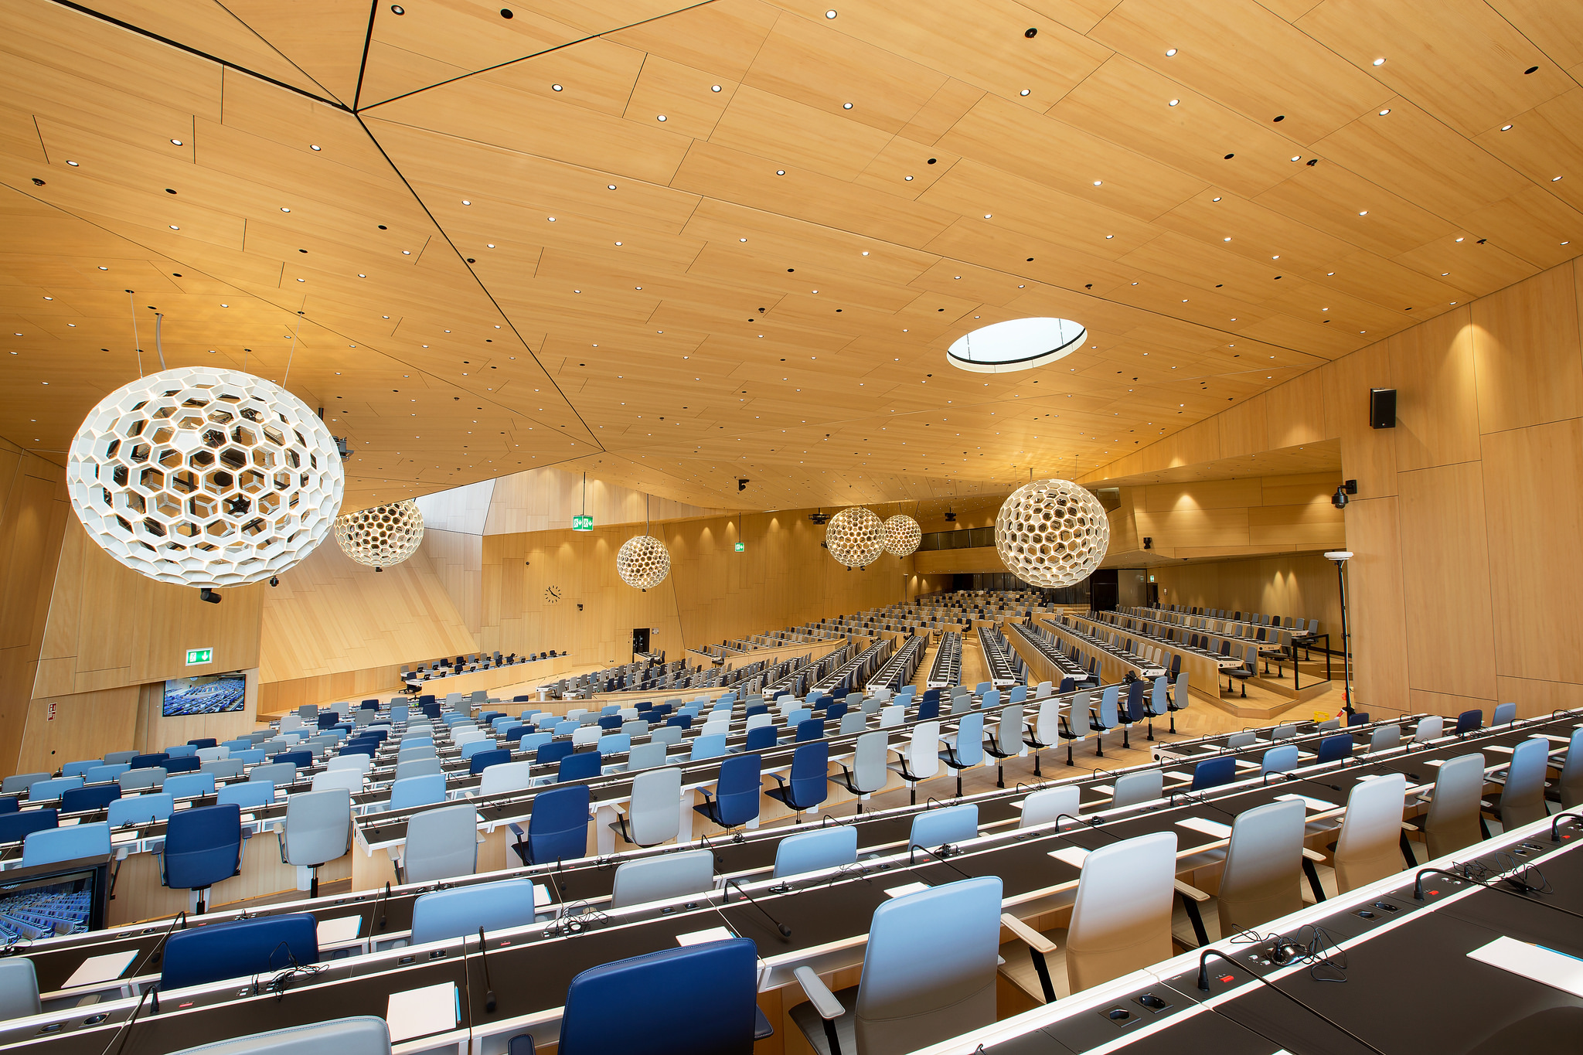
SCCR
Crews Studies
Eleven themes:
Preservation
Reproduction
Lending
Legal Deposit
Parallel Importation
Cross-Border Access
Orphan and Out of Commerce Works
Limitations on Liability
Contract Override
Technological Protection Measures
Translation
But what objective?
Image - Copyright: WIPO. Photo: Emmanuel Berrod. This work is licensed under a Creative Commons Attribution-NonCommercial-NoDerivs 3.0 IGO License.
Notes:
If there is a solution to the challenges faced by libraries, it will be in the specific committee for copyright – the Standing Committee on Copyright and Related Rights (or SCCR for short). Like the other committees, this commissions studies, discusses findings and best practices, and explores what can be done to correct problems identified. Its next meeting will be on 13-17 November in Geneva.
SCCR launched work in the mid-2000s, looking at exceptions and limitations to copyright which could favour access to knowledge around the world. This work rapidly fell into a number of categories – exceptions for libraries and archives, for people with print disabilities (which led to Marrakesh), for education and research institutions, and for people with other disabilities.
In the case of libraries, we have been lucky to benefit from two exhaustive studies – and an update – from Professor Kenneth Crews, looking at exceptions and limitations for libraries in national law around the world. We will receive a third edition this month.
This work, so far, has underlined how far many countries are from a full set of the exceptions that allow libraries to function, as well as how little even new legislation has looked to take account of the digital world. In doing so, the reports have provided a powerful argument for the need for more effective measures to accelerate progress.
The study has not focused specifically on cross-border uses, but the huge diversity of provisions underlines how complicated this is.
In its discussions, IFLA has been strong and consistent in calling for meaningful steps which will address the challenge of the growing inadequacy of the copyright system. In this, we have been supported by a number of major regional groups – Africa, Latin America and the Caribbean, and Asia-Pacific – which have underlined their support for an international treaty in this area.
As a means of organising discussions, the previous chair, Mr Martin Moscoso of Peru, structured discussions according to a table or chart covering eleven topics – preservation, reproduction, lending, legal deposit, parallel importation (can you buy a book from another country, even if it is available locally), cross-border activities, orphan and out of commerce works, limitations on liability, contract override, technological protection measures and translation of works.
Drawing on examples offered by IFLA members, as well as other research, IFLA has made the case for exceptions, or other relevant steps, in these areas, finding considerable support from among other Member States.

Slide 8
Effective steps to ensure that libraries and their users benefit from a complete and modern set of exceptions and limitations
Cross-border effect of exceptions and limitations to allow for international cooperation
Practical guidance/support to Member States in delivering good laws for libraries
Accessible evidence on copyright laws for libraries
Notes:
We reached the end of discussions on the Chair’s Chart at the end of 2016, and in 2017, Members of the Committee agreed to give the resulting table a semi-formal status, meaning that it could be the basis for ongoing discussions. The result clearly does need more work.
Overall, we continue to make the same arguments as previously – that we need effective steps to help those countries which do not have the right laws in place to make progress.
We need exceptions to work across borders.
We need practical support to Member States in implementing exceptions. Given that exceptions are as much part of copyright as rights themselves, WIPO should be providing as much tailored support as they do to the drafting of laws that create rights.
And they should make sure that the evidence collected and produced can be presented in a way that is most useful to researchers and others.

Slide 9
“All governments can introduce new exceptions and limitations, so we don’t need action at WIPO…“
“Licensing meets all needs for cross-border access…”
“There’s no way of stopping countries implementing overly broad exceptions and limitations…”
“We need to give publishers the time to find stable business models for the digital age…”
Notes:
Clearly there is some opposition to our asks. Rightholders and collecting societies among NGOs, and the EU and some other developed countries among Member States say that they do not want anything other than soft law. In practice, they have also blocked any progress in this direction.
They consistently use a number of arguments.
Firstly, they claim that there is no need for action at WIPO, as all member states have the freedom to introduce exceptions and limitations to copyright. While this may technically be true, the fact that progress has been so slow underlines that international action is necessary. For cross-border uses, it is well nigh impossible without international coordination. (The same argument could have been used for persons with print disabilities).
The rapid adoption of legislation to support access to books for people with print disabilities, following the Marrakesh Treaty, shows what action in Geneva can do. Moreover, the same countries and actors, for the most part, make exactly the same argument as we do to justify progress on resale rights or broadcasting.
Indeed, in those countries which tend to want to avoid new legislation, notably the US, any steps taken at WIPO are unlikely to lead to any major need for reform.
Secondly, they claim that thanks to licensing, there is no need for measures on cross-border access. While licensing may work in many cases, this argument is incorrect, given not only the large share of materials for which no licence is available, but also the clear market failures that still exist. Just because licensing works in one situation, it does not mean it works in all.
Thirdly, there is a less openly voiced concern about countries implementing excessively broad exceptions and limitations, which risk unfairly taking away revenues from authors and other rightholders, with no chance to appeal.
This is not only incorrect – since the TRIPS agreement, the World Trade Organisation has the competence to judge cases concerning limitations and exceptions to copyright – but also misses the point. The challenge today is that inadequate exceptions and limitations are either leaving people without access, or leading them to use unauthorized sites to access works they need but are not available to them through legal channels. This is exactly the opposite of the concern expressed.
Finally, there is the argument that at a time where rightholders are looking to adapt to a digital age, they do not need more disruption. This argument not only assumes that it is acceptable to put education, innovation and development on hold while we look for new business models, but also over-states what we are asking for.
Libraries are responsible institutions, staffed by professionals. They are not commercial actors, and have no motivation other than to serve their public. Ensuring effective exceptions and limitations will not libraries stop buying original materials, and by law they cannot lead to any unreasonable prejudice to the interests of rightholders.

Slide 10
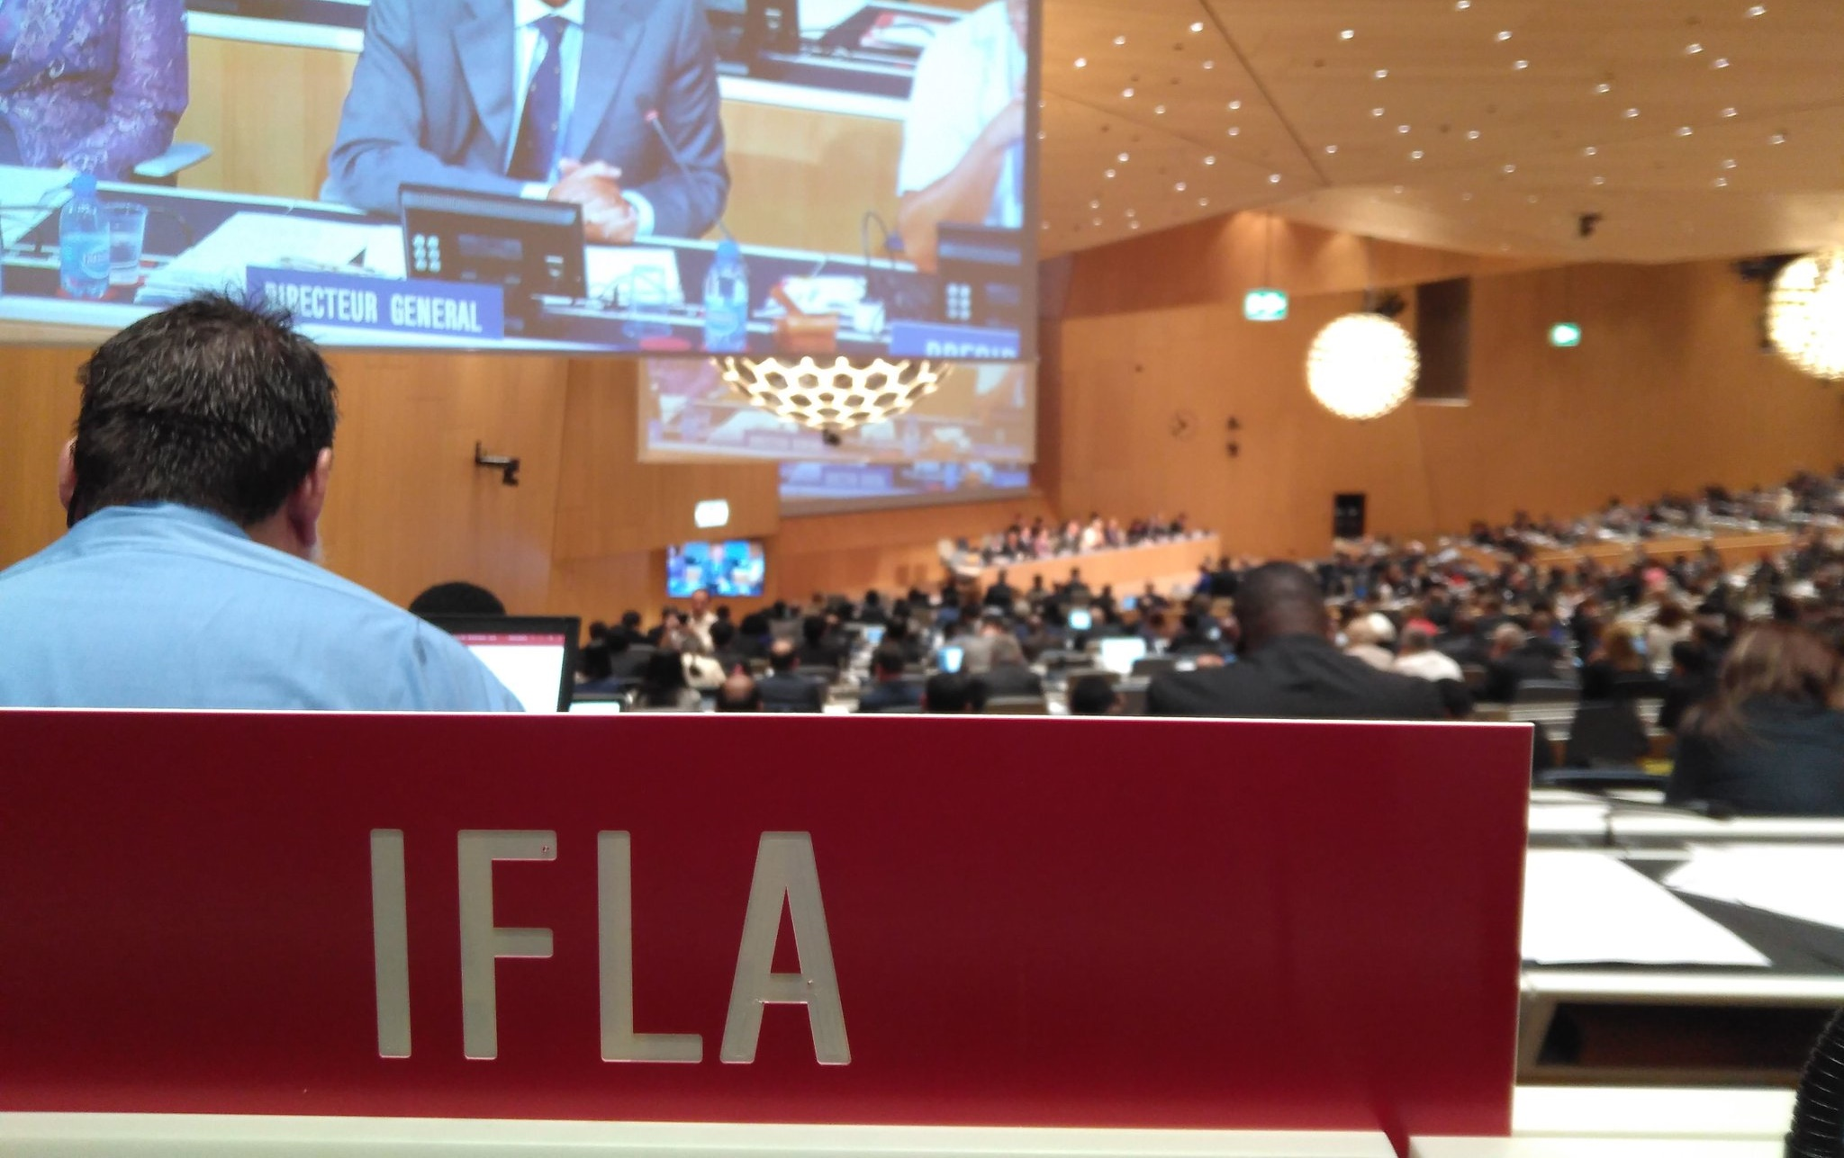
How You Can Help
Ask your copyright office to support libraries at WIPO
Share examples of where a lack of exceptions has made your work harder
Follow us and show your interest on social media!
Notes:
You can help us make progress. It is important that governments hear from their libraries, and understand that this is a priority. If they hear nothing, they may not feel the need to speak, or may even oppose effective steps forwards, under pressure from rightholders.
You can help us build stronger arguments by sharing stories about the challenges you face, both in your work at home, and across borders. Do you know researchers who have not been able to access works they need? Preservation projects which have not been able to go ahead? Unnecessary restrictions and costs placed on your work? Let us know!
And of course follow us during the next meeting, on 13-17 November, and help us show the governments at WIPO how much support there is for what we are doing! Don’t hesitate to use the hashtag #copyright4libraries and #SCCR, that we’ll be using too!

Slide 11
Follow us: @IFLA, #Copyright4Libraries
Contact us: stephen.wyber@ifla.org ariadna.matas@ifla.org
Notes:
So that’s the end of the presentation. Feel free to ask us questions directly now, or you can e-mail us later.

