Slide 1
Truths, Trends and Tropes:
Unpacking the Debate around
Copyright Exceptions and Limitations

Slide 2
Truths, Trends or Tropes ?
Unpacking the Debate around Copyright Exceptions and Limitations:
“Licenses can solve it all”
“Exceptions and Limitations do not mean the end of markets”
“There is no need for global normative work on exceptions and limitations”
And what does all this mean for the WIPO regional seminars?

Slide 3
"Licenses can solve it all"
AUDIENCE VOTE

Slide 4
Why do we have exceptions and limitations? (Teresa Hackett)
L&Es are an integral part of the international copyright system.
L&Es are essential for safeguarding fundamental user rights.
L&Es ensure that the legislator has a role in balancing interests in pursuit of public policy objectives.

Slide 5
Why can't we rely on licenses only? (Teresa Nobre)
Licenses can undermine the ability of public policy-makers to regulate user rights through public legal instruments
Licenses can raise privacy and policing issues, and override laws
Licenses are not available for every material, in every territory
Licenses don't create harmonized legal framework

Slide 6
Personal experience
Joy Ramlogan, MI student, University of Toronto
Fuschia Norwich, MI student, University of Toronto

Slide 7
"Licences can‘t solve it all"
L

Slide 8
Hot Seat
Notes:
8

Slide 9
“Exceptions and Limitations mean the end of markets”
AUDIENCE VOTE

Slide 10
What's the impact of L&E in the market? (Victoria Owen)
Canada has long had limitations and exceptions in its Copyright Law; has maintained a robust publishing environment
Educational institutions spend millions each year; Research libraries alone in Canada spent $293 million (2014-15)
Libraries and EIs use purchase, license, freely available material, and fair dealing for access
An illustrative, representative example is the University of Guelph. 92% of the materials acquired are digital; they negotiate the rights to provide legal opportunities for the use of works. Students at the university have the opportunity to access course readings in a myriad of ways: throught purchase, and using course reserves.
In the course reserve environment access is provided in the following ways:
54% through direct links from licensed materials,
24% open and free Internet content,
6% via transactional licences,
16% under fair dealing

Slide 11
“Exceptions and Limitations do not mean the end of markets”
Canada the market is growing stronger, despite the expansion of fair dealing in 2012
According to Statistics Canada, in 2016, total Canadian book sales increased 0.5% from 2014 to $1.4 billion. Canadian authors accounted for 51.1% of total 2016 sales, amounting to $701.2 million.
Stats Canada reports that publisher profit margins steadily increased from 9.4% in 2012; 9.6% in 2014; and 10.2% in 2016.
According to BookNet, in 2017, Candian sales of print books through traditional channels increased compared to 2016 levels. The total market was up 4.4% to $1.03 billion in sales, with 51.4 million in unit sales, up 1.7% from the previous year.
In 2017, Canadian-owned publishers reported a sales volume of 2.9 million units, with corresponding retail sales revenues of $51.2 million. This represents an increase of 5.6% in units sold and a 5.0% increase in sales revenue from 2016. (BookNet)

Slide 12
Hot seat
Notes:
12

Slide 13
„There is no need for global normative work on E&L“
AUDIENCE VOTE

Slide 14
Education today occurs across borders (Nikola Wachter)
45,7% educators and 56,1% learners regularly send digital works via email, clouds, chats, social networks etc
24,5% learners indicated to have taken an online distance learning course offered by an educational institution based abroad
75,8% of educators and learners believe that a cross-border solution would improve teaching and learning
EU Commission, 2016

Slide 15
Real-life experience: Education
Project in International Collaborative Teaching, University of Saskatchewan
Amal Hussein, MI Student, U of Toronto, cross-border barriers in distance education
Lubnaa Jaumbally, MI student, U of Toronto, cross-border barriers in discance education

Slide 16
Real-life experience: Libraries, Archives and Museums
Australia's colonial cultural heritage in the UK
The personal archive of Gabriel García Márquez at the Harry Ransom Center (University of Texas, US)
Classical music research project across borders (Cuba, US and Spain)

Slide 17
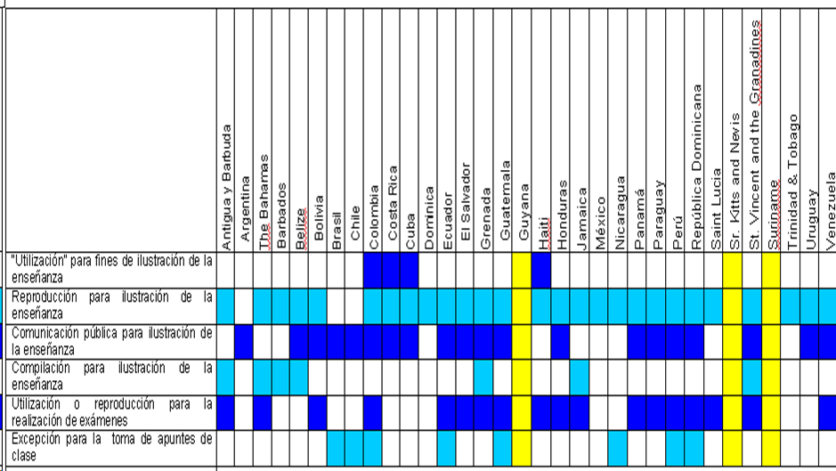
Reviewing existing international copyright legislation
Monroy Study, WIPO, 2009

Slide 18
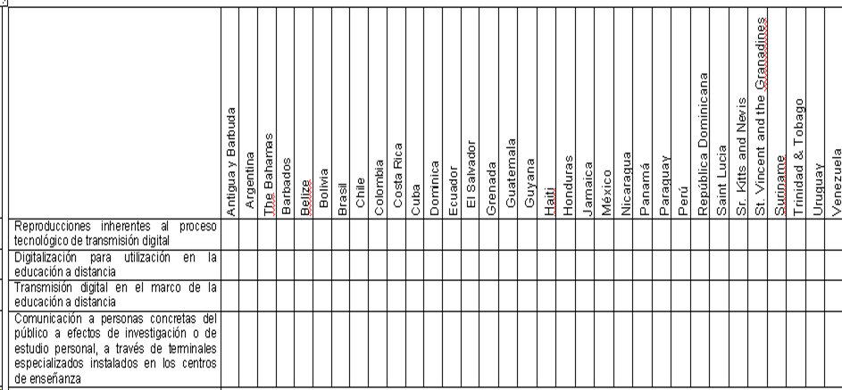
Reviewing existing international copyright legislation
Monroy Study, WIPO, 2009

Slide 19
"There is no a need for global normative work on E&L"
This Lack of balanced national exceptions and balanced minimum international standards creates legal uncertainty and barriers to:
International cooperation and development of a strong, efficient and legal international exchange of services and resources to foster education
Creation of and access to educational resources and services
Investment in international and national digital education activities
Enforcement of copyright law
Fulfillment of obligations to human rights as regard to education.

Slide 20
How an international instrument will help
Solving inefficiencies by
Overcoming ambiguities and uncertainties on what is possible (interpretation of the three-step test and other instruments)
Providing an enabling minimum framework & facilitating the adoption of balanced national laws where needed
Avoiding the threat of international litigation
Countering illegitimate pressure and disinformation by stakeholders
Overcoming a lack of understanding of the importance of exceptions
Creating incentives and resources for all players to engage on the issues

Slide 21
Hot Seat
Notes:
21

Slide 22
What does all this mean for the regionals?
Looking to the regional seminars
International normative work on E&L is important
International progress on libraries, archives and museums
Draft Treaty on Educational and Research Activities (TERA)
Raising regional voices, challenges and solutions around EXCEPTIONS & LIMITATIONS
Genuine involvement of beneficiaries in the preparations and in the seminars themselves

Slide 23
Truths, Trends and Tropes:
Thank you!
Unpacking the Debate around
Copyright Exceptions and Limitations

