Slide 1
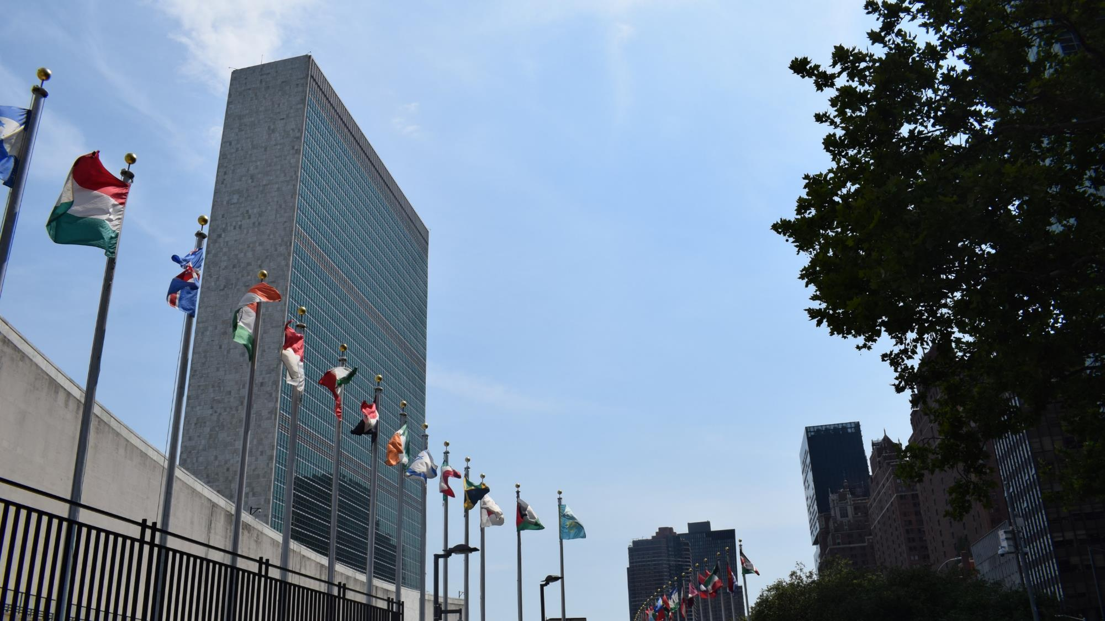
IFLA Webinar
What's on the Agenda for IFLA and the Sustainable Development Goals in 2019?
#Lib4Dev #DA2I
ifla.org/libraries-development

Slide 2
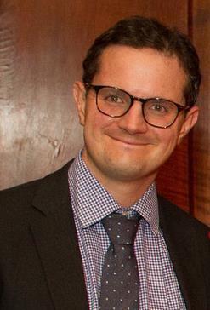
Stephen Wyber
Manager, Policy and Advocacy
IFLA

Slide 4
The SDGs affirm that access to information is essential for development across the board

Slide 5
The SDGs are an opportunity to explain the importance of libraries, and call for support

Slide 6
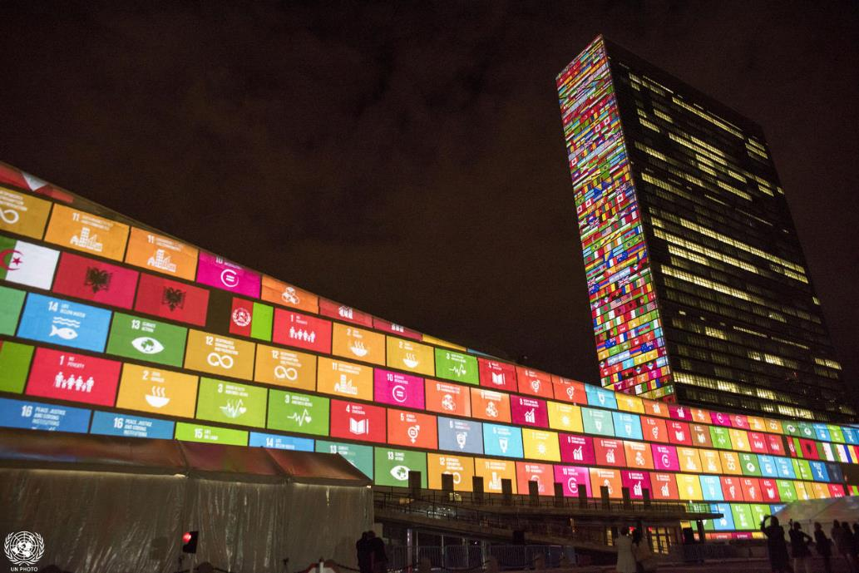
Organised every year in the United Nations Headquarters, New York
More than 2000 participants from around the world (including Heads and Deputy Heads of State and Government, Ministers, Vice-Ministers and other ministerial-level officials, Civil Society, Private Sector and Academia)
Every year Member States volunteer to be part of the Voluntary National Reviews (42 countries will have their VNR in 2019)
https://sustainabledevelopment.un.org/hlpf
© UN Photo/Cia Pak

Slide 7
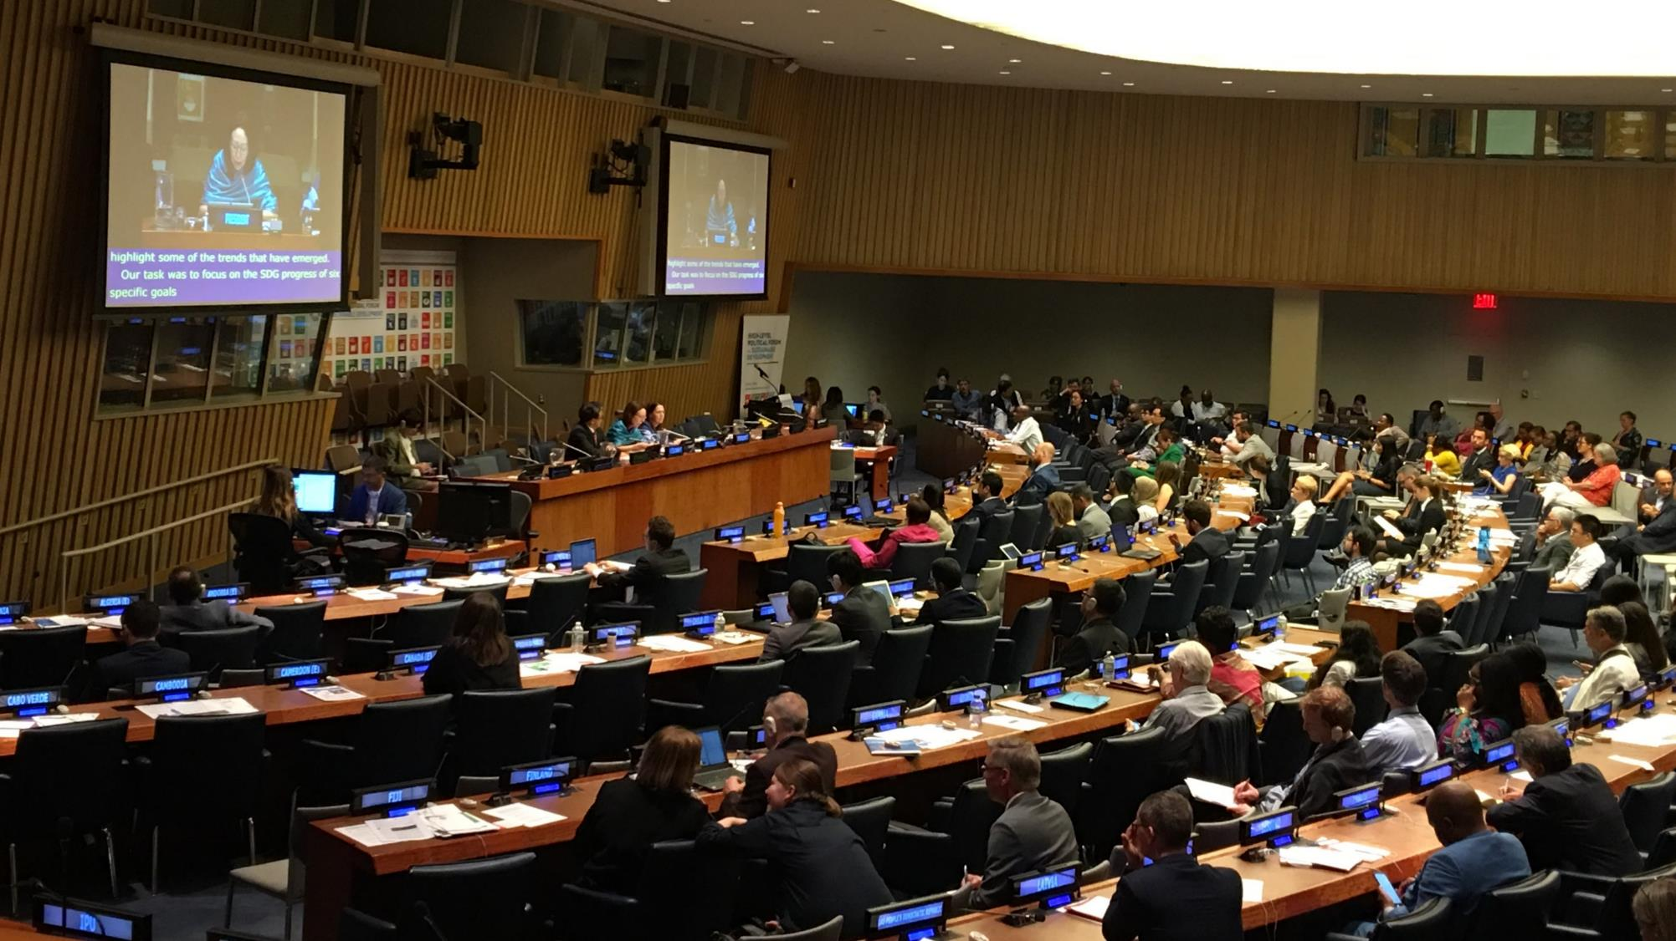
Member States have to (should) ‘consult with civil society, prepare a report on progress in implementing the SDGs, and present it at HLPF

Slide 8
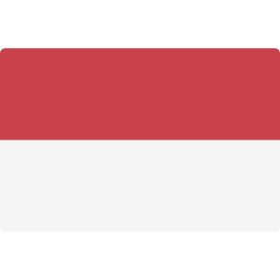
42 COUNTRIES HAVE VOLUNTEERED TO DO VNRs IN 2019

Slide 10
Focus SDGs for 2019
…a great opportunity for libraries
Notes:
We chose, as I you’ve probably noticed, the Sustainable Development Goals.
Glòria has set out why these were so special. Unlike their predecessors, and indeed unlike any other globally agreed document, they offered a framework to explain the work of libraries.
All the dimensions of our work, all the ways in which our institutions improve lives.

Slide 11
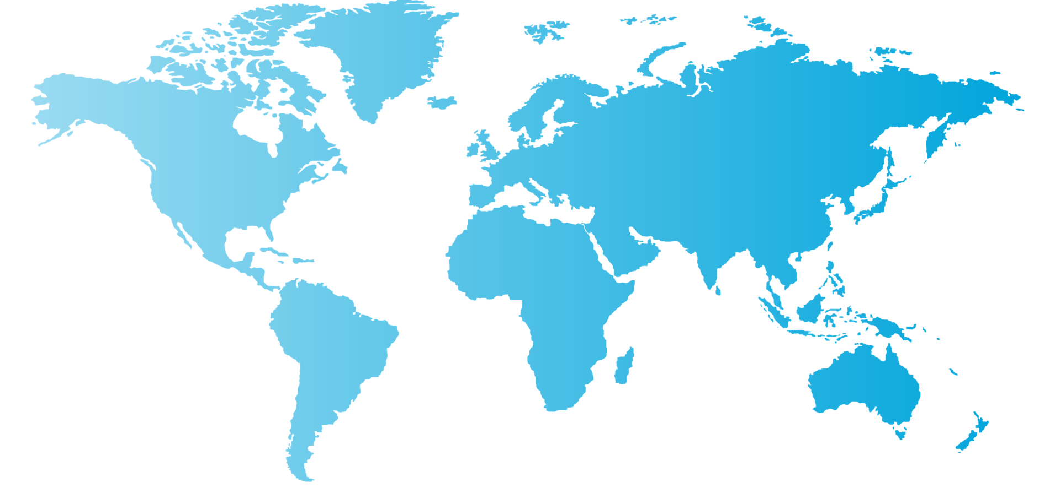
UNESCO, ILO, UNFCCC, UNEP, UNDP, regional commissions
Key UN agencies related to the 2019 HLPF focus SDGs
Notes:
We chose, as I you’ve probably noticed, the Sustainable Development Goals.
Glòria has set out why these were so special. Unlike their predecessors, and indeed unlike any other globally agreed document, they offered a framework to explain the work of libraries.
All the dimensions of our work, all the ways in which our institutions improve lives.

Slide 12
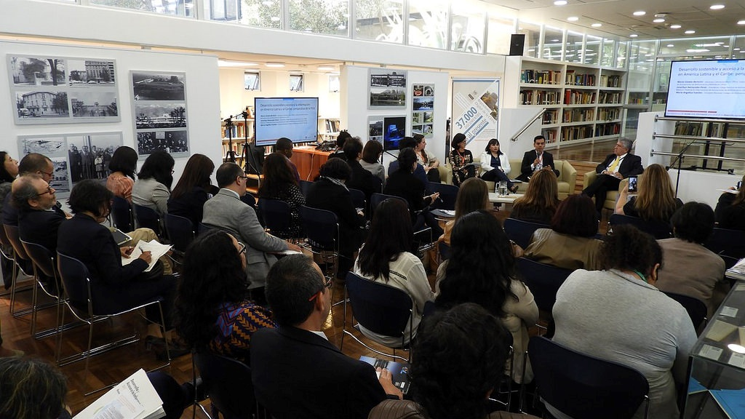
The importance of access to information to achieve sustainable development in Latin America and the Caribbean
Side event co-organised by IFLA and ECLAC’s Hernán Santa Cruz Library during the
Second Meeting of the Forum of the Countries of Latin America and the Caribbean on Sustainable Development in Santiago │ 19 April 2018, Santiago de Chile
Notes:
We chose, as I you’ve probably noticed, the Sustainable Development Goals.
Glòria has set out why these were so special. Unlike their predecessors, and indeed unlike any other globally agreed document, they offered a framework to explain the work of libraries.
All the dimensions of our work, all the ways in which our institutions improve lives.

Slide 13
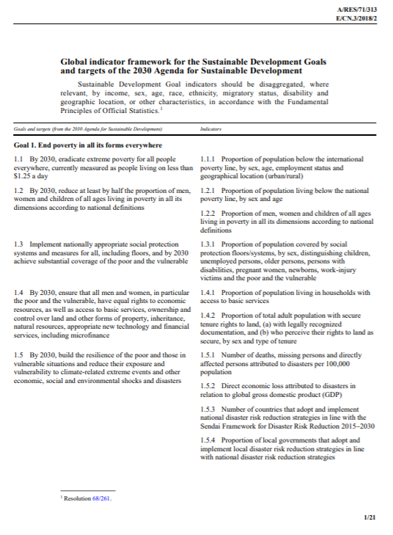
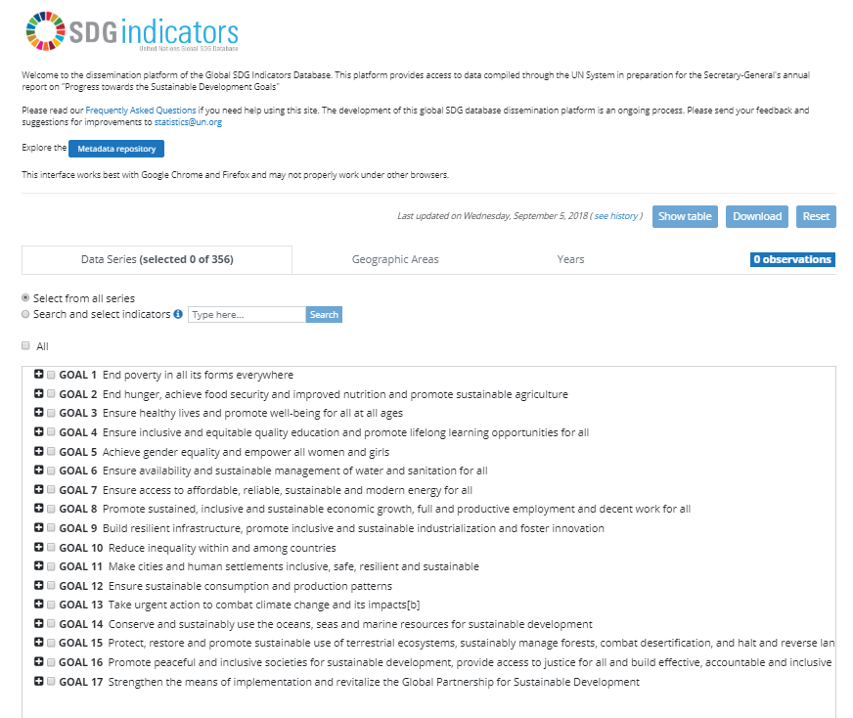
Notes:
We chose, as I you’ve probably noticed, the Sustainable Development Goals.
Glòria has set out why these were so special. Unlike their predecessors, and indeed unlike any other globally agreed document, they offered a framework to explain the work of libraries.
All the dimensions of our work, all the ways in which our institutions improve lives.

Slide 14
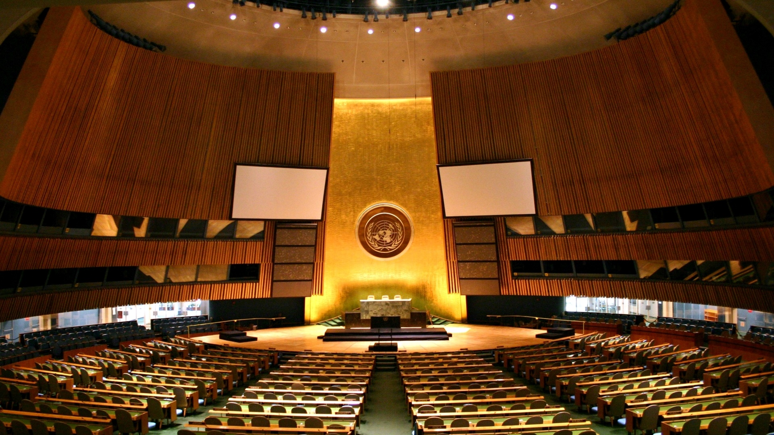
The terms of reference of the review of the 2030 Agenda will be defined in 2019
We need to defend access to information, promote culture, and make development policies – including the UN process - inclusive
Photo: Patrick Gruban, CC-BY-SA 2.0, https://bit.ly/1NPB4Ve

Slide 15
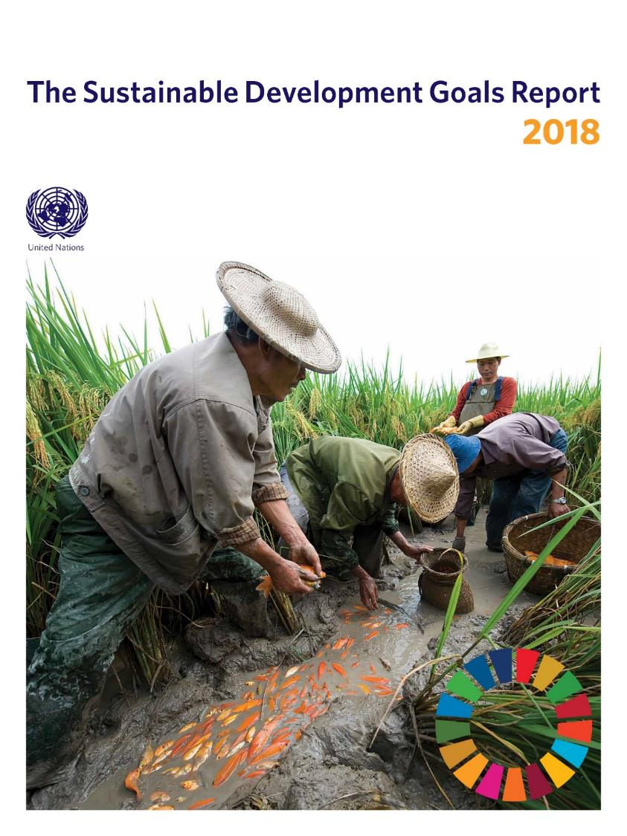
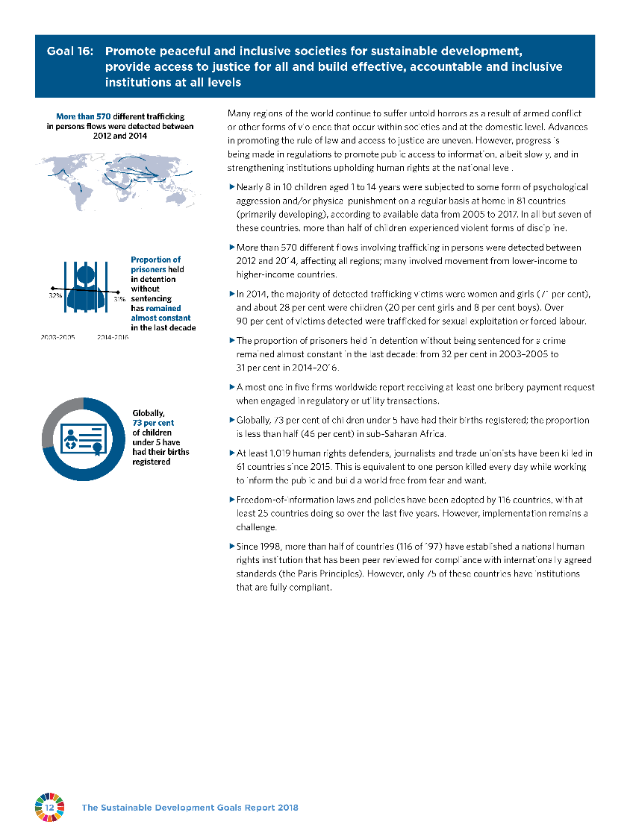
Notes:
We chose, as I you’ve probably noticed, the Sustainable Development Goals.
Glòria has set out why these were so special. Unlike their predecessors, and indeed unlike any other globally agreed document, they offered a framework to explain the work of libraries.
All the dimensions of our work, all the ways in which our institutions improve lives.

Slide 16
Notes:
We chose, as I you’ve probably noticed, the Sustainable Development Goals.
Glòria has set out why these were so special. Unlike their predecessors, and indeed unlike any other globally agreed document, they offered a framework to explain the work of libraries.
All the dimensions of our work, all the ways in which our institutions improve lives.

Slide 17
Libraries and the UN 2030 Agenda in 2018-2019
Sep 2018
Oct 2018
Nov-Dec 2018
Jan-Mar
2019
Mar-May 2019
Jun-Jul
2019
Global Level
25 September
Anniversary of 2030 Agenda
Preparation for Regional SDG Forums
Regional SDG Forums Held, Make Reports
HLPF: thematic review of SDGs, VNRs, agreement of Ministerial Declaration
Call for Examples of SDG Partnerships
28 September
Access to Information Day
Thematic SDG Forums
Thematic SDG Forums
National Level
Access to Information Day Events
VNR Countries Organise Consultations
VNR Draft Reports
VNR Reports Finalised, Submitted
VNR Reports Presented. HLPF Participation
Data
5-8 November
IAEG SDG
22-24 October
World Data Forum
IAEG SDG
SDG Data report published
Consultation on Revised SDG Indicators
IFLA Priorities
Celebrate 2030 Agenda and Importance of Access to Information
Support VNR Countries to Prepare Inputs.
Engage with UN Agencies
Gather examples of partnerships.
Support VNRs. Answer Data Consultation
Support engagement in regional/ thematic fora. Prepare HLPF 2018
Engagement in thematic/ regional fora. Finish DA2I Report 2019. NGO Statement
Work with Members to advocate for HLPF. Engage in HLPF. Launch DA2I Report.

Slide 18
Join us on 25 September:
Print the IFLA poster
Put it up in your library
Take photos and share them on social media using the hashtags! (remember to include #Act4SDGs)
Notes:
We chose, as I you’ve probably noticed, the Sustainable Development Goals.
Glòria has set out why these were so special. Unlike their predecessors, and indeed unlike any other globally agreed document, they offered a framework to explain the work of libraries.
All the dimensions of our work, all the ways in which our institutions improve lives.

Slide 19
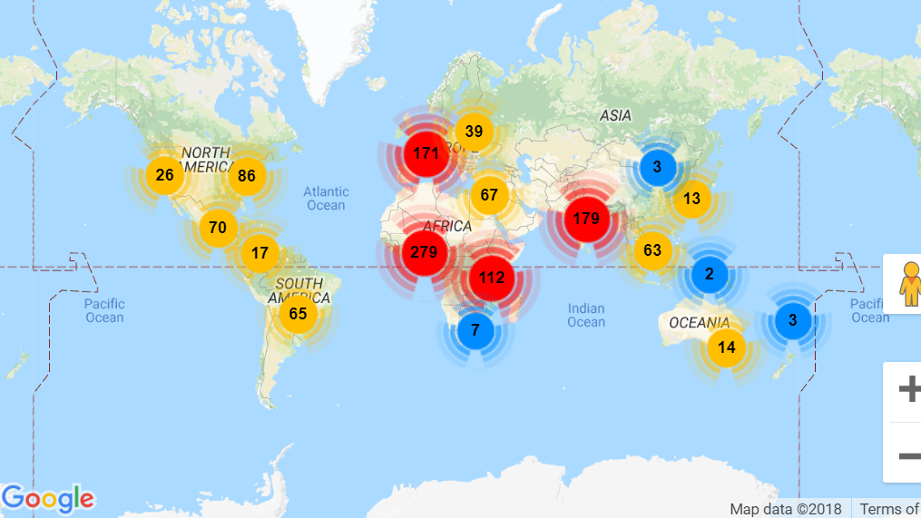

Slide 20
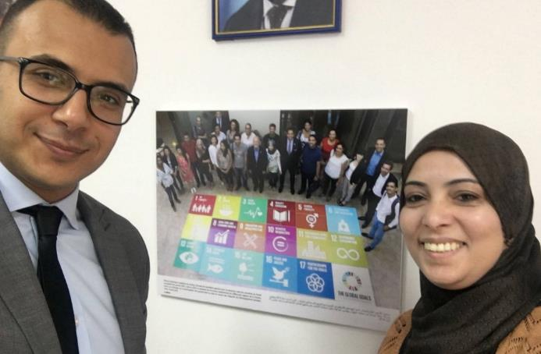
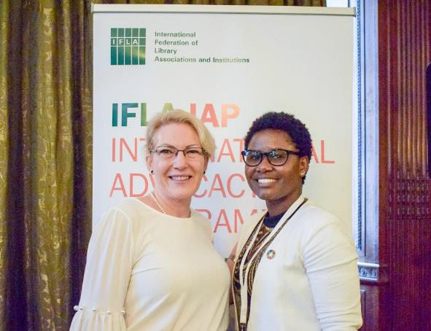
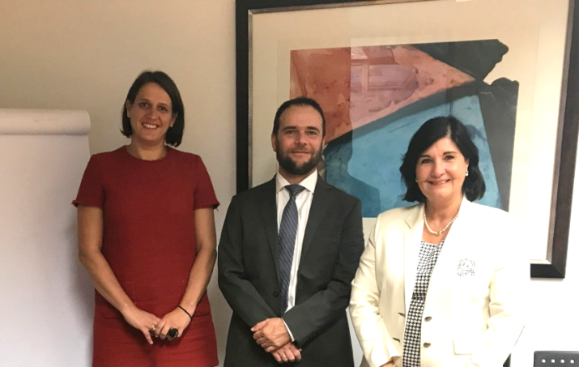
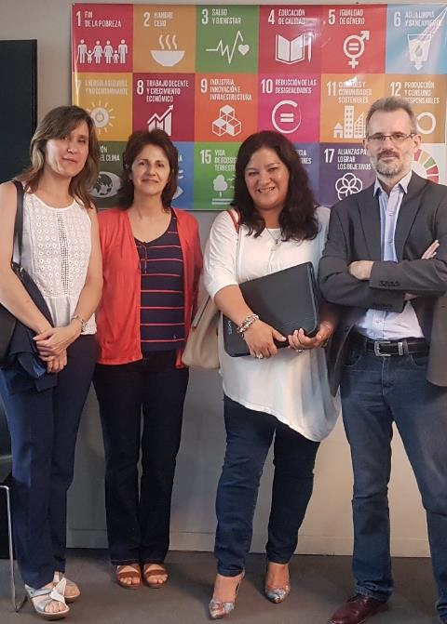
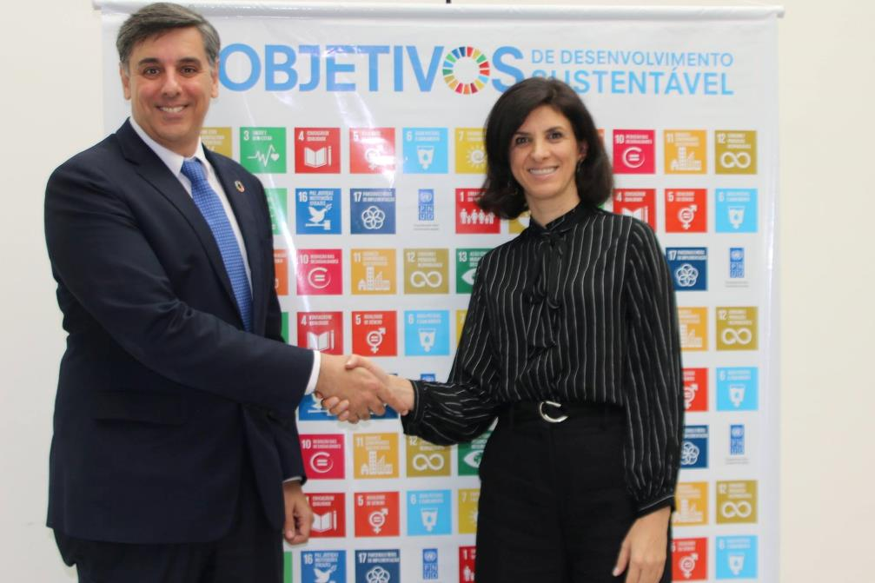
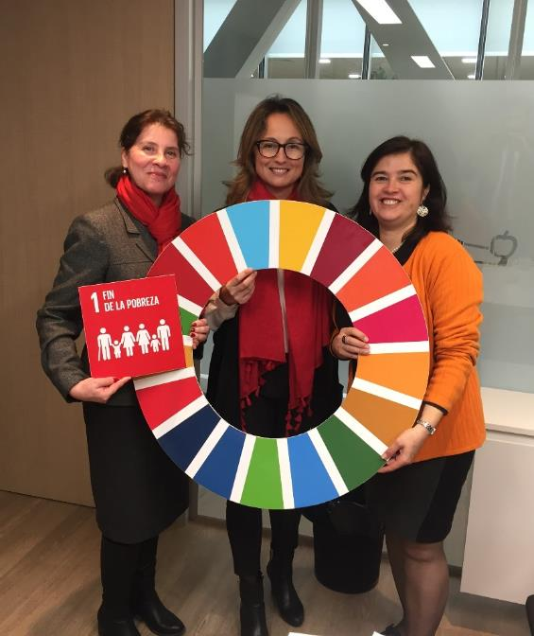
For VNR countries – identify who is responsible, find out about the process, make them your friends!

Slide 22
Libraries and the UN 2030 Agenda in 2018-2019
Sep 2018
Oct 2018
Nov-Dec 2018
Jan-Mar
2019
Mar-May 2019
Jun-Jul
2019
Global Level
25 September
Anniversary of 2030 Agenda
Preparation for Regional SDG Forums
Regional SDG Forums Held, Make Reports
HLPF: thematic review of SDGs, VNRs, agreement of Ministerial Declaration
Call for Examples of SDG Partnerships
28 September
Access to Information Day
Thematic SDG Forums
Thematic SDG Forums
National Level
Access to Information Day Events
VNR Countries Organise Consultations
VNR Draft Reports
VNR Reports Finalised, Submitted
VNR Reports Presented. HLPF Participation
Data
5-8 November
IAEG SDG
22-24 October
World Data Forum
IAEG SDG
SDG Data report published
Consultation on Revised SDG Indicators
IFLA Priorities
Celebrate 2030 Agenda and Importance of Access to Information
Support VNR Countries to Prepare Inputs.
Engage with UN Agencies
Gather examples of partnerships.
Support VNRs. Answer Data Consultation
Support engagement in regional/ thematic fora. Prepare HLPF 2018
Engagement in thematic/ regional fora. Finish DA2I Report 2019. NGO Statement
Work with Members to advocate for HLPF. Engage in HLPF. Launch DA2I Report.

Slide 23
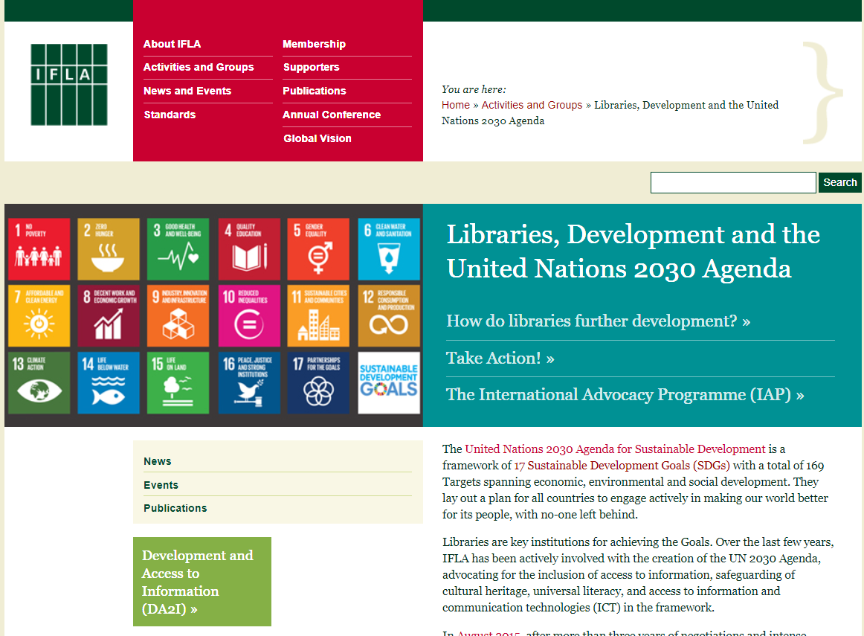
Notes:
We chose, as I you’ve probably noticed, the Sustainable Development Goals.
Glòria has set out why these were so special. Unlike their predecessors, and indeed unlike any other globally agreed document, they offered a framework to explain the work of libraries.
All the dimensions of our work, all the ways in which our institutions improve lives.

Slide 24
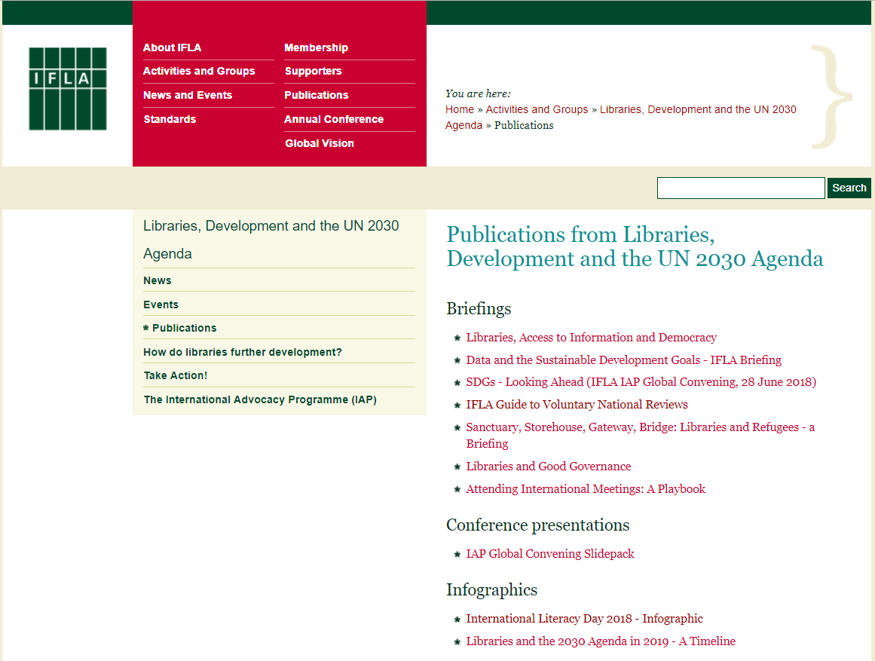
Notes:
We chose, as I you’ve probably noticed, the Sustainable Development Goals.
Glòria has set out why these were so special. Unlike their predecessors, and indeed unlike any other globally agreed document, they offered a framework to explain the work of libraries.
All the dimensions of our work, all the ways in which our institutions improve lives.

Slide 25
Questions? Stay in touch! Share!
ifla.org/libraries-development
@IFLA_Lib4Dev
#Lib4Dev
#DA2I
DA2I@ifla.org
Stephen.Wyber@ifla.org

